Slide 1
Cyclistic Case Study 2016
By Shreeram

Slide 2
Summary
The Subscribers account for 76% of Total Users and the Customers and Dependents account for 24% of Total Users
Key Takeaways:
Customers tend to use the service more on weekends and Subscribers tend to use it more on weekdays
Customers take long duration trips while Subscribers tend to take short duration trips
There is a significant increase of Usage from both Usertypes during the summer months i.e. June to August.
There can be more options in Membership so that Customers can choose their Subscriptions

Slide 3
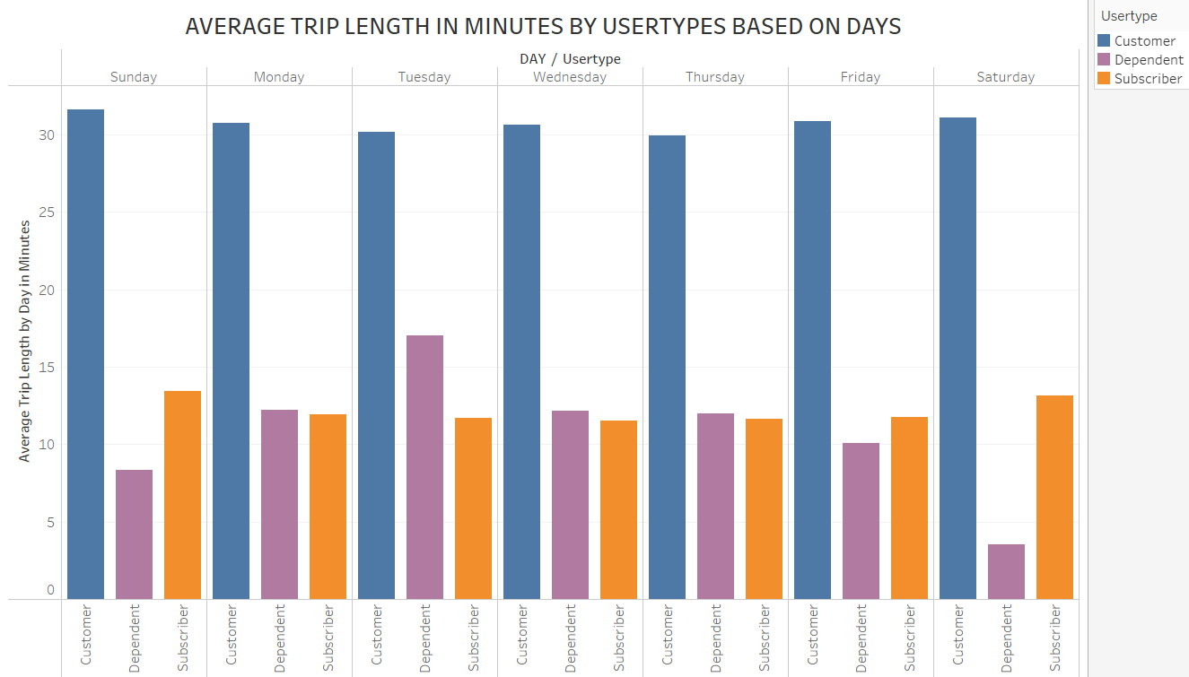

Slide 4
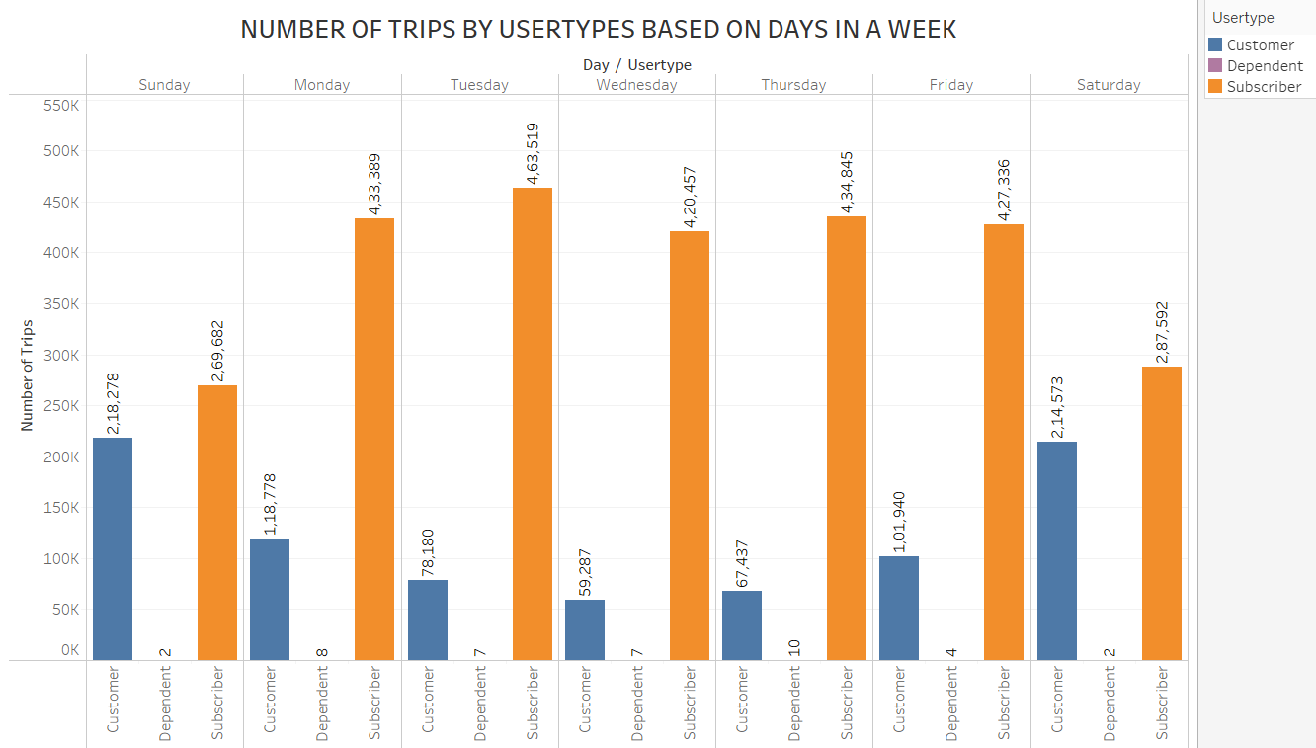

Slide 5
Potential Causes for differences in Weekday and Weekend Usage
Hypothesis:
Tourists or Visitors tend to use the service more on the Weekends
Data Required:
Survey for Day Pass Users requesting whether they are Tourists or Residents
Analysis Next Steps:
Identify the trend between Number of Tourists/Visitors and Residents using Day Passes

Slide 6
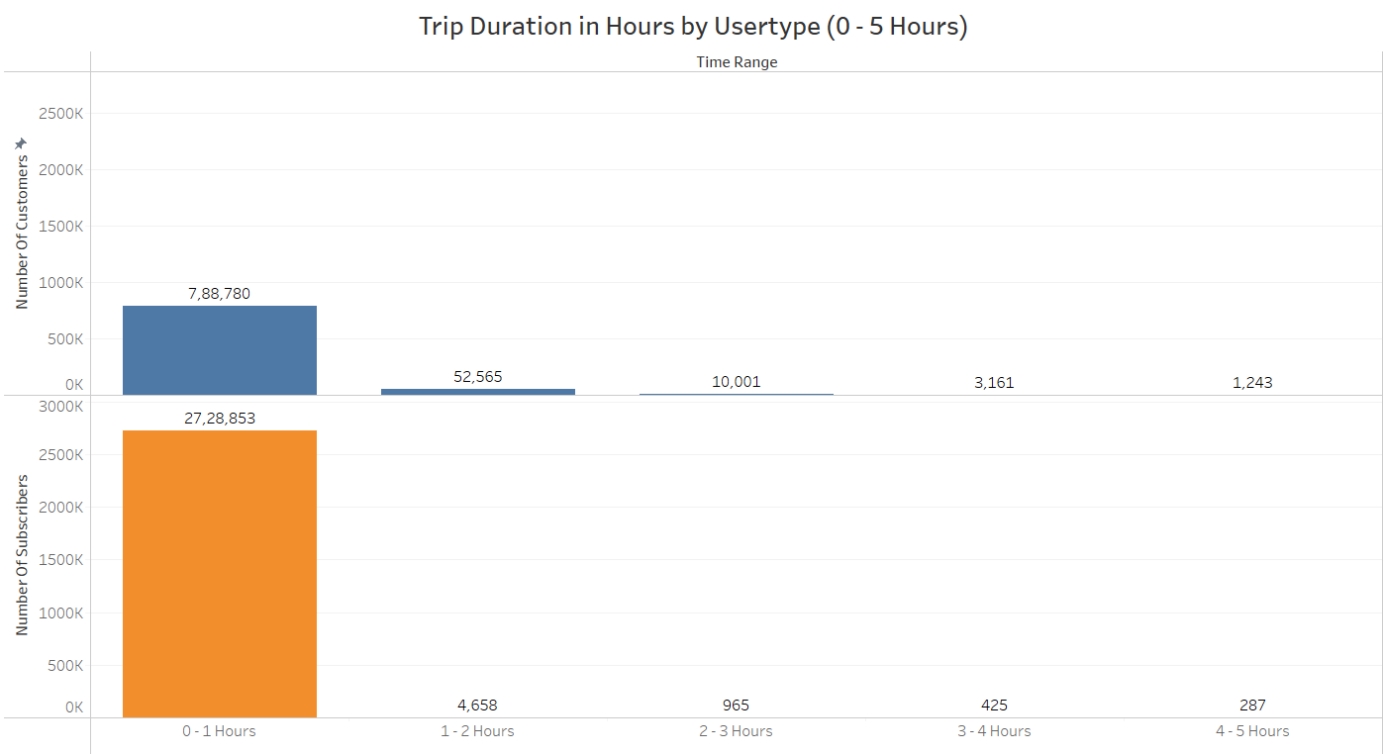

Slide 7
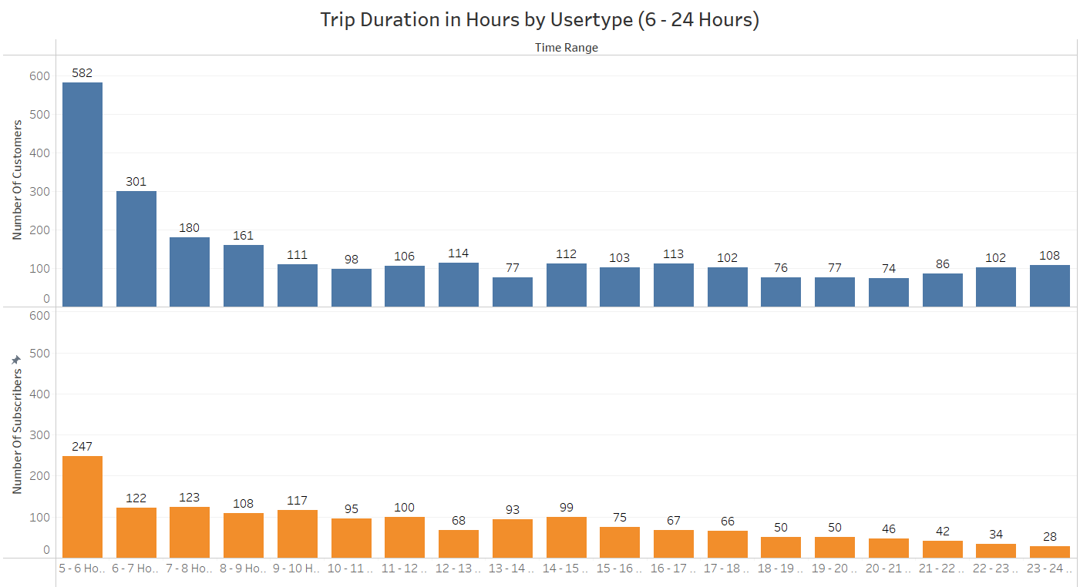

Slide 8
Potential Causes for differences in Trip Duration Hours
Hypothesis:
Hourly Price costs more than Day Pass
Data required:
Summary Report with Hourly Price and the Number of Hours Customers usually use the service
Analysis next steps:
Do analysis between Hourly Usage and Daily Usage
Do analysis between the prices for hours and Day Passes

Slide 9
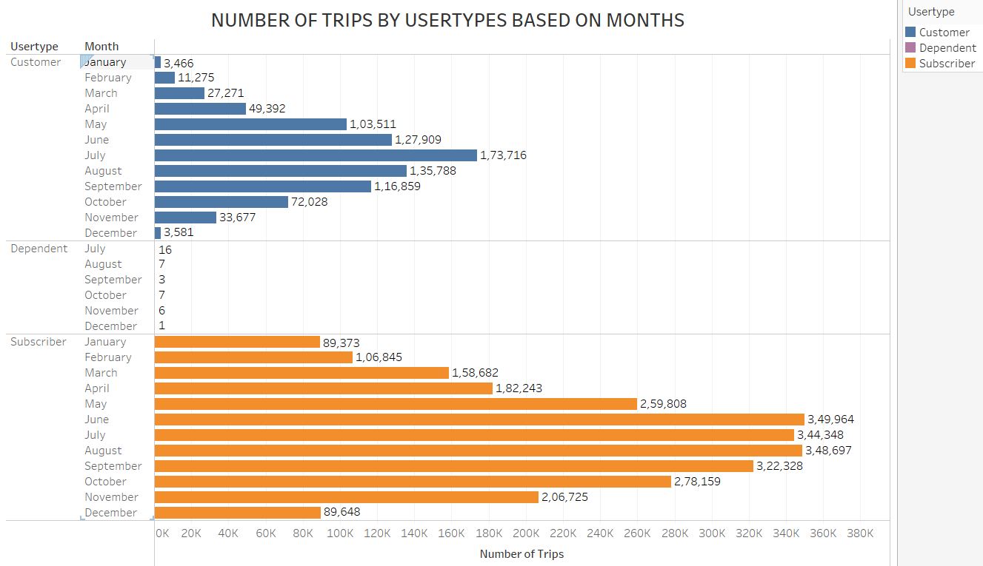

Slide 10
Potential causes for increase in Number of Trips in May - October
Hypothesis:
Users tend to travel more based on the Weather Conditions
Data required:
Weather Summary reports for Each Month
Analysis next steps:
Check if there are temperature changes in May and October
Check for ideal temperature or weather that helps in more usage of the service

Slide 11
Action Plan
Options in Yearly Subscriptions
More options in Subscriptions for Yearly or Monthly can help add more Subscribers
Options in Day Passes
More options in Day Passes for Hourly or Half Day trips can help add more Users to the Service
Create a Tailored Marketing focused on Busy Months
Digital Marketing can focus more on Months where there are more users using the Service as well as attracting new users who might be visiting

Slide 12
THANK YOU

